Slide 1
Data Engineering Ch1 Data Engineering Described د. معاذ الحجايا قسم علم البيانات كلية تكنولوجيا المعلومات جامعة مؤتة الفصل الصيفي 2024

Slide 2
What Is Data Engineering?
If you work in data or software, you may have noticed data engineering emerging from the shadows and now sharing the stage with data science.
Data engineering is one of the hottest fields in data and technology, and for a good reason.
It builds the foundation for data science and analytics in production.
This chapter explores what data engineering is, how the field was born and its evolution, the skills of data engineers, and with whom they work.
Despite the current popularity of data engineering, there’s a lot of confusion about what data engineering means and what data engineers do.
Data engineering has existed in some form since companies started doing things with data—such as predictive analysis, descriptive analytics, and reports—and came into sharp focus alongside the rise of data science in the 2010s.
For the purpose of this book, it’s critical to define what data engineering and data engineer mean.

Slide 3
What Is Data Engineering?
First, let’s look at the landscape of how data engineering is described and develop some terminology we can use throughout this book.
Endless definitions of data engineering exist.
In early 2022, a Google exact-match search for “what is data engineering?” returns over 91,000 unique results.
Before we give our definition, here are a few examples of how some experts in the field define data engineering:

Slide 4
—From “Data Engineering and Its Main Concepts” by AlexSoft
“Data engineering is a set of operations aimed at creating interfaces and mechanisms for the flow and access of information. It takes dedicated specialists—data engineers— to maintain data so that it remains available and usable by others. In short, data engineers set up and operate the organization’s data infrastructure, preparing it for further analysis by data analysts and scientists”.

Slide 5
—Jesse Anderson
“The first type of data engineering is SQL-focused. The work and primary storage of the data is in relational databases. All of the data processing is done with SQL or a SQL-based language. Sometimes, this data processing is done with an ETL tool.2 The second type of data engineering is Big Data–focused. The work and primary storage of the data is in Big Data technologies like Hadoop, Cassandra, and HBase. All of the data processing is done in Big Data frameworks like MapReduce, Spark, and Flink. While SQL is used, the primary processing is done with programming languages like Java, Scala, and Python”.

Slide 6
—Maxime Beauchemin
“In relation to previously existing roles, the data engineering field could be thought of as a superset of business intelligence and data warehousing that brings more elements from software engineering. This discipline also integrates specialization around the operation of so-called “big data” distributed systems, along with concepts around the extended Hadoop ecosystem, stream processing, and in computation at scale”.

Slide 7
—Lewis Gavin
“Data engineering is all about the movement, manipulation, and management of data”.

Slide 8
Data Engineering Defined
When we unpack the common threads of how various people define data engineering, an obvious pattern emerges: a data engineer gets data, stores it, and prepares it for consumption by data scientists, analysts, and others.
We define data engineering and data engineer as follows:

Slide 9
Data Engineering Defined – cont.
Data engineering is the development, implementation, and maintenance of systems and processes that take in raw data and produce high-quality, consistent information that supports downstream use cases, such as analysis and machine learning. Data engineering is the intersection of security, data management, DataOps, data architecture, orchestration, and software engineering. A data engineer manages the data engineering lifecycle, beginning with getting data from source systems and ending with serving data for use cases, such as analysis or machine learning.

Slide 10
The Data Engineering Lifecycle
It is all too easy to fixate on technology and miss the bigger picture myopically.
This book centers around a big idea called the data engineering lifecycle (figure next slide), which we believe gives data engineers the holistic context to view their role.
The data engineering lifecycle shifts the conversation away from technology and toward the data itself and the end goals that it must serve.
The stages of the data engineering lifecycle are as follows:
Generation
Storage
Ingestion
Transformation
Serving

Slide 11
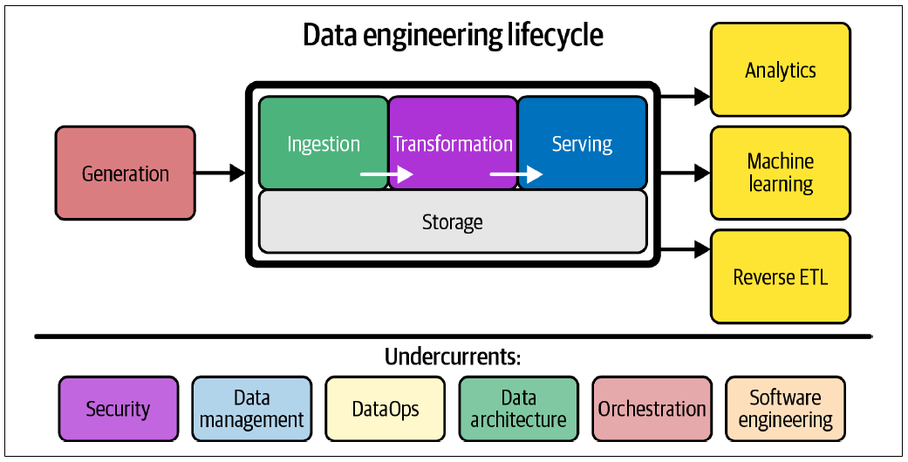
The Data Engineering Lifecycle – cont.

Slide 12
The Data Engineering Lifecycle – cont.
The data engineering lifecycle also has a notion of undercurrents—critical ideas across the entire lifecycle.
These include security, data management, DataOps, data architecture, orchestration, and software engineering.
We cover the data engineering lifecycle and its undercurrents more extensively in next chapter.
Still, we introduce it here because it is essential to our definition of data engineering and the discussion that follows in this chapter.
Now that you have a working definition of data engineering and an introduction to its lifecycle, let’s take a step back and look at a bit of history.

Slide 13
Evolution of the Data Engineering - The 2020s: Engineering for the data lifecycle
At the time of this writing, the data engineering role is evolving rapidly.
We expect this evolution to continue at a rapid clip for the foreseeable future.
Whereas data engineers historically tended to the low-level details of monolithic frameworks such as Hadoop, Spark, or Informatica, the trend is moving toward decentralized, modularized, managed, and highly abstracted tools.
Indeed, data tools have proliferated at an astonishing rate (see figure next slide).
Popular trends in the early 2020s include the modern data stack, representing a collection of off-the-shelf open source and third-party products assembled to make analysts’ lives easier.
At the same time, data sources and data formats are growing both in variety and size.
Data engineering is increasingly a discipline of interoperation, and connecting various technologies like LEGO bricks, to serve ultimate business goals.

Slide 14
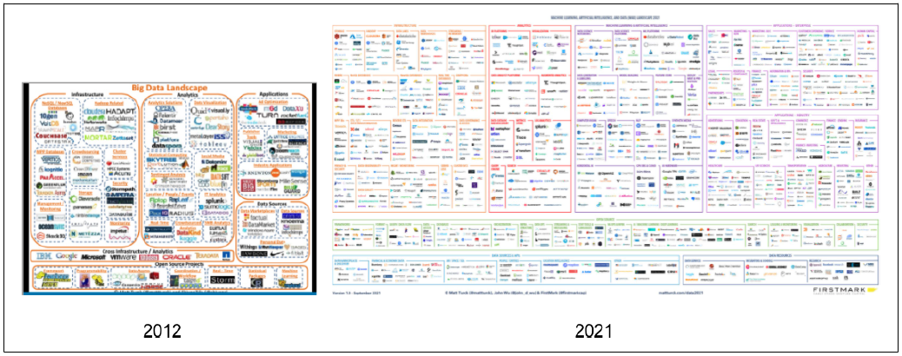
Data Landscape in 2012 versus 2021

Slide 15
Data Engineering and Data Science
Where does data engineering fit in with data science?
There’s some debate, with some arguing data engineering is a subdiscipline of data science.
We believe data engineering is separate from data science and analytics.
They complement each other, but they are distinctly different.
Data engineering sits upstream from data science (figure next slide), meaning data engineers provide the inputs used by data scientists (downstream from data engineering), who convert these inputs into something useful.

Slide 16

Data engineering sits upstream from data science

Slide 17
Data Science Hierarchy of Needs
Consider the Data Science Hierarchy of Needs (figure next slide).
In 2017, Monica Rogati published this hierarchy in an article that showed where AI and machine learning (ML) sat in proximity to more “mundane” areas such as data movement/storage, collection, and infrastructure.
Although many data scientists are eager to build and tune ML models, the reality is an estimated 70% to 80% of their time is spent toiling in the bottom three parts of the hierarchy—gathering data, cleaning data, processing data—and only a tiny slice of their time on analysis and ML.
Rogati argues that companies need to build a solid data foundation (the bottom three levels of the hierarchy) before tackling areas such as AI and ML.

Slide 18
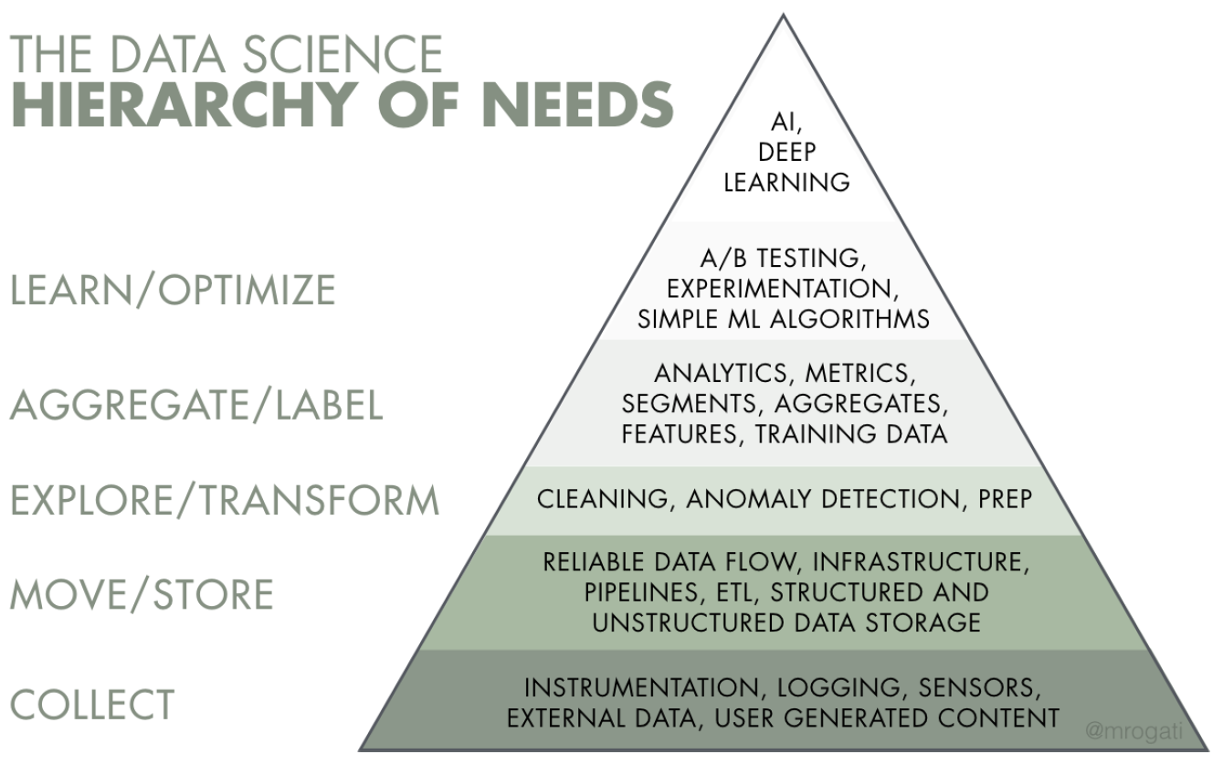
The Data Science Hierarchy of Needs – cont.

Slide 19
The Data Science Hierarchy of Needs – cont.
Data scientists aren’t typically trained to engineer production-grade data systems, and they end up doing this work haphazardly because they lack the support and resources of a data engineer.
In an ideal world, data scientists should spend more than 90% of their time focused on the top layers of the pyramid: analytics, experimentation, and ML.
When data engineers focus on these bottom parts of the hierarchy, they build a solid foundation for data scientists to succeed.
With data science driving advanced analytics and ML, data engineering straddles the divide between getting data and getting value from data (see figure next slide).
We believe data engineering is of equal importance and visibility to data science, with data engineers playing a vital role in making data science successful in production.

Slide 20

A data engineer gets data and provides value from the data

Slide 21
Data Engineering Skills and Activities
The skill set of a data engineer encompasses the “undercurrents” of data engineering: security, data management, DataOps, data architecture, and software engineering.
This skill set requires an understanding of how to evaluate data tools and how they fit together across the data engineering lifecycle.
It’s also critical to know how data is produced in source systems and how analysts and data scientists will consume and create value after processing and curating data.
Finally, a data engineer juggles a lot of complex moving parts and must constantly optimize along the axes of cost, agility, scalability, simplicity, reuse, and interoperability (figure next slide).

Slide 22
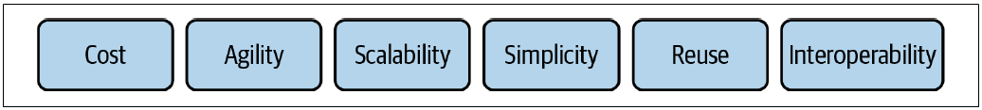
The balancing act of data engineering

Slide 23
Data Engineering Skills and Activities – cont.
As we discussed, in the recent past, a data engineer was expected to know and understand how to use a small handful of powerful and monolithic technologies (Hadoop, Spark, Teradata, Hive, and many others) to create a data solution.
Utilizing these technologies often requires a sophisticated understanding of software engineering, networking, distributed computing, storage, or other low-level details.
Their work would be devoted to cluster administration and maintenance, managing overhead, and writing pipeline and transformation jobs, among other tasks.
Nowadays, the data-tooling landscape is dramatically less complicated to manage and deploy.
Modern data tools considerably abstract and simplify workflows.

Slide 24
Data Engineering Skills and Activities – cont.
As a result, data engineers are now focused on balancing the simplest and most cost-effective, best-of-breed services that deliver value to the business.
The data engineer is also expected to create agile data architectures that evolve as new trends emerge.
What are some things a data engineer does not do?
A data engineer typically does not directly build ML models, create reports or dashboards, perform data analysis, build key performance indicators (KPIs), or develop software applications.
A data engineer should have a good functioning understanding of these areas to serve stakeholders best.

Slide 25
The Background and Skills of a Data Engineer
Data engineering is a fast-growing field, and a lot of questions remain about how to become a data engineer.
Because data engineering is a relatively new discipline, little formal training is available to enter the field.
Universities don’t have a standard data engineering path. Although a handful of data engineering boot camps and online tutorials cover random topics, a common curriculum for the subject doesn’t yet exist.
People entering data engineering arrive with varying backgrounds in education, career, and skill set.
Everyone entering the field should expect to invest a significant amount of time in self-study.

Slide 26
The Background and Skills of a Data Engineer – cont.
If you’re pivoting your career into data engineering, we’ve found that the transition is easiest when moving from an adjacent field, such as software engineering, ETL development, database administration, data science, or data analysis.
These disciplines tend to be “data aware” and provide good context for data roles in an organization.
They also equip folks with the relevant technical skills and context to solve data engineering problems.
Despite the lack of a formalized path, a requisite body of knowledge exists that we believe a data engineer should know to be successful.
By definition, a data engineer must understand both data and technology.

Slide 27
The Background and Skills of a Data Engineer – cont.
With respect to data, this entails knowing about various best practices around data management.
On the technology end, a data engineer must be aware of various options for tools, their interplay, and their trade-offs. This requires a good understanding of software engineering, DataOps, and data architecture.
Zooming out, a data engineer must also understand the requirements of data consumers (data analysts and data scientists) and the broader implications of data across the organization.
Data engineering is a holistic practice; the best data engineers view their responsibilities through business and technical lenses.

Slide 28
Business Responsibilities
The macro responsibilities we list in this section aren’t exclusive to data engineers but are crucial for anyone working in a data or technology field.
Because a simple Google search will yield tons of resources to learn about these areas, we will simply list them for brevity:
Know how to communicate with nontechnical and technical people.
Communication is key, and you need to be able to establish rapport and trust with people across the organization.
We suggest paying close attention to organizational hierarchies, who reports to whom, how people interact, and which silos exist.
These observations will be invaluable to your success.

Slide 29
Business Responsibilities – cont.
Understand how to scope and gather business and product requirements.
You need to know what to build and ensure that your stakeholders agree with your assessment.
In addition, develop a sense of how data and technology decisions impact the business.

Slide 30
Business Responsibilities – cont.
Understand the cultural foundations of Agile, DevOps, and DataOps.
Many technologists mistakenly believe these practices are solved through technology.
We feel this is dangerously wrong.
Agile, DevOps, and DataOps are fundamentally cultural, requiring buy-in across the organization.

Slide 31
Business Responsibilities – cont.
Control costs.
You’ll be successful when you can keep costs low while providing outsized value.
Know how to optimize for time to value, the total cost of ownership, and opportunity cost.
Learn to monitor costs to avoid surprises.

Slide 32
Business Responsibilities – cont.
Learn continuously.
The data field feels like it’s changing at light speed.
People who succeed in it are great at picking up new things while sharpening their fundamental knowledge.
They’re also good at filtering, determining which new developments are most relevant to their work, which are still immature, and which are just fads.
Stay abreast of the field and learn how to learn.

Slide 33
Business Responsibilities – cont.
A successful data engineer always zooms out to understand the big picture and how to achieve outsized value for the business.
Communication is vital, both for technical and nontechnical people.
We often see data teams succeed based on their communication with other stakeholders; success or failure is rarely a technology issue.
Knowing how to navigate an organization, scope and gather requirements, control costs, and continuously learn will set you apart from the data engineers who rely solely on their technical abilities to carry their career.

Slide 34
Technical Responsibilities
You must understand how to build architectures that optimize performance and cost at a high level, using prepackaged or homegrown components.
Ultimately, architectures and constituent technologies are building blocks to serve the data engineering lifecycle.
Recall the stages of the data engineering lifecycle:
Generation
Storage
Ingestion
Transformation
Serving

Slide 35
Technical Responsibilities - cont.
The undercurrents of the data engineering lifecycle are the following:
Security
Data management
DataOps
Data architecture
Orchestration
Software engineering

Slide 36
Technical Responsibilities - cont.
Zooming in a bit, we discuss some of the tactical data and technology skills you’ll need as a data engineer in this section; we discuss these in more detail in subsequent chapters.
People often ask, should a data engineer know how to code? Short answer: yes.
A data engineer should have production-grade software engineering chops. We note that the nature of software development projects undertaken by data engineers has changed fundamentally in the last few years.
Fully managed services now replace a great deal of low-level programming effort previously expected of engineers, who now use managed open source, and simple plug-and-play software-as-a-service (SaaS) offerings.
For example, data engineers now focus on high-level abstractions or writing pipelines as code within an orchestration framework.

Slide 37
Technical Responsibilities - cont.
Even in a more abstract world, software engineering best practices provide a competitive advantage, and data engineers who can dive into the deep architectural details of a codebase give their companies an edge when specific technical needs arise.
In short, a data engineer who can’t write production-grade code will be severely hindered, and we don’t see this changing anytime soon.
Data engineers remain software engineers, in addition to their many other roles.
What languages should a data engineer know?
We divide data engineering programming languages into primary and secondary categories.
At the time of this writing, the primary languages of data engineering are SQL, Python, a Java Virtual Machine (JVM) language (usually Java or Scala), and bash.

Slide 38
Technical Responsibilities - cont.
Data engineers may also need to develop proficiency in secondary programming languages, including R, JavaScript, Go, Rust, C/C++, C#, and Julia.
Developing in these languages is often necessary when popular across the company or used with domain-specific data tools.
For instance, JavaScript has proven popular as a language for user-defined functions in cloud data warehouses.
At the same time, C# and PowerShell are essential in companies that leverage Azure and the Microsoft ecosystem.

Slide 39
The Continuum of Data Engineering Roles, from A to B
Although job descriptions paint a data engineer as a “unicorn” who must possess every data skill imaginable, data engineers don’t all do the same type of work or have the same skill set.
Data maturity is a helpful guide to understanding the types of data challenges a company will face as it grows its data capability.
It’s beneficial to look at some critical distinctions in the kinds of work data engineers do.
Though these distinctions are simplistic, they clarify what data scientists and data engineers do and avoid lumping either role into the unicorn bucket.

Slide 40
The Continuum of Data Engineering Roles, from A to B – cont.
In data science, there’s the notion of type A and type B data scientists.
Type A data scientists—where A stands for analysis—focus on understanding and deriving insight from data.
Type B data scientists—where B stands for building—share similar backgrounds as type A data scientists and possess strong programming skills.
The type B data scientist builds systems that make data science work in production.
Borrowing from this data scientist continuum, we’ll create a similar distinction for two types of data engineers:

Slide 41
Type A data engineers
A stands for abstraction.
In this case, the data engineer avoids undifferentiated heavy lifting, keeping data architecture as abstract and straightforward as possible and not reinventing the wheel.
Type A data engineers manage the data engineering lifecycle mainly by using entirely off-the-shelf products, managed services, and tools.
Type A data engineers work at companies across industries and at all levels of data maturity.

Slide 42
Type B data engineers
B stands for build.
Type B data engineers build data tools and systems that scale and leverage a company’s core competency and competitive advantage.
In the data maturity range, a type B data engineer is more commonly found at companies in stage 2 and 3 (scaling and leading with data), or when an initial data use case is so unique and mission-critical that custom data tools are required to get started.

Slide 43
The Continuum of Data Engineering Roles, from A to B – cont.
Type A and type B data engineers may work in the same company and may even be the same person!
More commonly, a type A data engineer is first hired to set the foundation, with type B data engineer skill sets either learned or hired as the need arises within a company.

Slide 44
Data Engineers Inside an Organization
Data engineers don’t work in a vacuum.
Depending on what they’re working on, they will interact with technical and nontechnical people and face different directions (internal and external).
Let’s explore what data engineers do inside an organization and with whom they interact.

Slide 45
Internal-Facing Versus External-Facing Data Engineers
A data engineer serves several end users and faces many internal and external directions (figure next slide).
Since not all data engineering workloads and responsibilities are the same, it’s essential to understand whom the data engineer serves.
Depending on the end-use cases, a data engineer’s primary responsibilities are external facing, internal facing, or a blend of the two.

Slide 46

The directions a data engineer faces

Slide 47
Internal-Facing Versus External-Facing Data Engineers – cont.
An external-facing data engineer typically aligns with the users of external-facing applications, such as social media apps, Internet of Things (IoT) devices, and ecommerce platforms.
This data engineer architects, builds, and manages the systems that collect, store, and process transactional and event data from these applications.
The systems built by these data engineers have a feedback loop from the application to the data pipeline, and then back to the application (figure next slide).

Slide 48
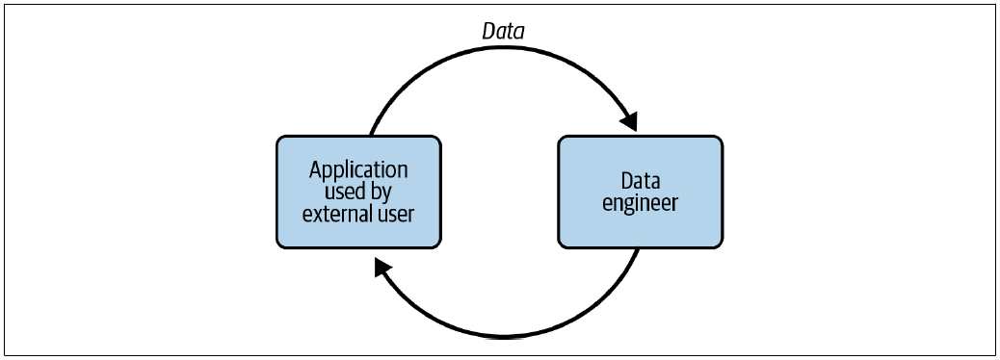
External-facing data engineer systems

Slide 49
External-facing data engineer systems – cont.
External-facing data engineering comes with a unique set of problems.
External-facing query engines often handle much larger concurrency loads than internal-facing systems.
Engineers also need to consider putting tight limits on queries that users can run to limit the infrastructure impact of any single user.
In addition, security is a much more complex and sensitive problem for external queries, especially if the data being queried is multitenant (data from many customers and housed in a single table).

Slide 50
Internal-facing data engineer
An internal-facing data engineer typically focuses on activities crucial to the needs of the business and internal stakeholders (figure next slide).
Examples include creating and maintaining data pipelines and data warehouses for BI dashboards, reports, business processes, data science, and ML models.
External-facing and internal-facing responsibilities are often blended.
In practice, internal-facing data is usually a prerequisite to external-facing data.
The data engineer has two sets of users with very different requirements for query concurrency, security, and more.

Slide 51

Internal-facing data engineer – cont.

Slide 52
Data Engineers and Other Technical Roles
In practice, the data engineering lifecycle cuts across many domains of responsibility.
Data engineers sit at the nexus of various roles, directly or through managers, interacting with many organizational units.
Let’s look at whom a data engineer may impact.
In this section, we’ll discuss technical roles connected to data engineering (figure next slide).
The data engineer is a hub between data producers, such as software engineers, data architects, and DevOps or site-reliability engineers (SREs), and data consumers, such as data analysts, data scientists, and ML engineers.
In addition, data engineers will interact with those in operational roles, such as DevOps engineers.
Given the pace at which new data roles come into vogue (analytics and ML engineers come to mind), this is by no means an exhaustive list.

Slide 53
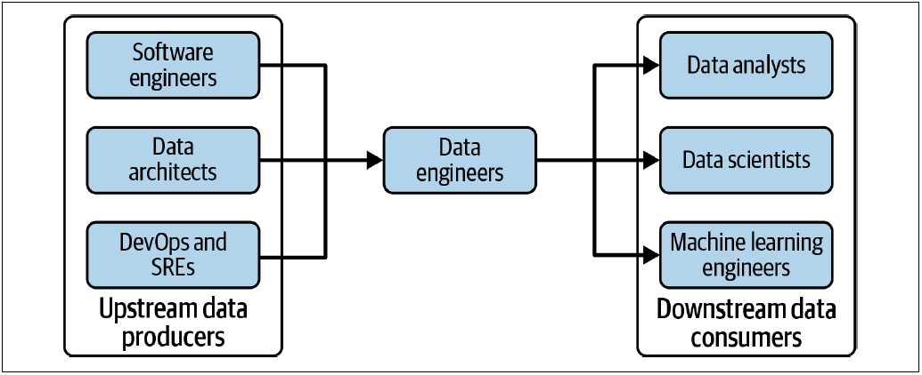
Key technical stakeholders of data engineering

